Slide 1
Building Construction Practice
Section A

Slide 2
Structures
In civil engineering, "structures" refer to engineered systems designed to support loads, resist forces, and provide stability. They include buildings, bridges, dams, towers, tunnels, and other infrastructure components, constructed using materials like concrete, steel, timber, or composites to ensure safety, functionality, and durability.

Slide 3
Load Transfer Mechanism
Load transfer mechanism refers to the method by which forces and loads acting on a structure, such as gravity, wind, seismic, or live loads, are transmitted through its various components to the foundation and ultimately to the ground. It involves how structural elements (beams, columns, slabs, walls, etc.) distribute and resist these forces to maintain stability and ensure safety.

Slide 4
Types of structures
From the viewpoint of load transfer mechanisms, are categorized based on how they handle and transfer loads to their foundations. The main types are:
1. Load-Bearing Structures
Transfer loads directly through walls to the foundation.
Common in traditional construction, such as brick masonry buildings.
2. Framed Structures
Use a skeleton of beams, columns, and slabs to transfer loads.
Types:
Rigid Frame: Beam-column joints resist bending (e.g., steel or reinforced concrete frames).
Pin-Jointed Frame: Joints allow rotation, transfer axial forces only (e.g., trusses).

Slide 5
3. Truss Structures
Composed of interconnected triangular units.
Transfer loads through axial forces in members, efficient for large spans (e.g., roofs, bridges).
4. Shell Structures
Curved surfaces (e.g., domes, vaults) transfer loads through compression and tension.
Used in large-span enclosures.
5. Cable Structures
Use tensioned cables to support loads (e.g., suspension bridges, cable-stayed roofs).

Slide 6
6. Arch Structures
Transfer loads through compression along the curved profile, redirecting forces to supports.
7. Plate Structures
Flat, thin structures like slabs transfer loads primarily in bending.
8. Grid or Space Frame Structures
Three-dimensional frameworks transferring loads in multiple directions, offering high stiffness.

Slide 7
9. Tensile Structures
Rely on pre-stressed tensile elements (e.g., membranes or fabric) to resist loads.
10. Hybrid Structures
Combine multiple load transfer mechanisms for optimized performance (e.g., cable-supported domes, arch-supported frames).

Slide 8
Load Bearing Structure
Load-bearing structures are systems in which the walls bear the weight of the building's roof, floors, and other loads, transmitting these forces directly to the foundation. These structures rely on vertical elements (such as walls) to support and transfer loads, without the need for a separate skeletal framework of beams and columns.

Slide 9
Key Features:
Walls as Load-Carrying Elements:
Walls serve dual purposes: supporting structural loads and enclosing spaces.
Both vertical (dead and live loads) and lateral (wind and seismic) forces are carried primarily by the walls.
Material Use:
Typically constructed using materials with high compressive strength, such as:
Brick masonry
Stone masonry
Concrete blocks
Adobe or rammed earth (in traditional construction)

Slide 10
Absence of a Skeleton Framework:
Unlike framed structures, there is no independent beam-column arrangement. The walls directly transmit the loads to the foundation.
Foundation:
Usually wider and shallower than framed structures, designed to distribute the loads effectively.

Slide 11
Applications:
Residential Buildings:
Commonly used for low-rise residential buildings.
Traditional Structures:
Heritage buildings, rural construction, and areas with limited access to advanced construction technologies.
Economic Solutions:
Popular in regions with low labor and material costs for masonry.

Slide 12
Advantages:
Cost-Effective:
Fewer materials required compared to framed structures (no beams or columns).
Simple Construction:
Does not require advanced technology or skilled labor.
Thermal Insulation:
Thick walls provide better insulation against heat and cold.
Durability:
Materials like stone and masonry are long-lasting.

Slide 13
Disadvantages:
Limited Height:
Not suitable for high-rise buildings due to the excessive weight of load-bearing walls.
Less Flexible Layout:
Wall placement is fixed for structural reasons, limiting interior space design.
Large Wall Thickness:
Reduces usable floor area, especially for taller buildings.
Vulnerability to Earthquakes:
Poor performance under seismic loads due to brittleness and lack of ductility.

Slide 14
Framed Structure
A framed structure is a construction system in which a skeletal framework of beams and columns carries the building’s loads. These structural members transfer the loads to the foundation, ensuring stability, durability, and flexibility in design.

Slide 15
Key Features:
Skeletal Framework:
Composed of vertical (columns) and horizontal (beams) members interconnected to form a rigid framework.
Walls serve as partitions, not load-bearing elements.
Load Transfer Mechanism:
Loads from slabs, walls, and roofs are transferred to beams, then to columns, and finally to the foundation.

Slide 16
Material Use:
Common materials include:
Reinforced concrete (RCC)
Steel
Timber (for smaller structures)
Composite materials (e.g., steel and concrete)
Flexibility in Design:
Allows for open floor plans and larger spans, suitable for modern architectural needs.
Foundation:
Can be shallow (isolated or strip footings) or deep (pile or raft foundations) depending on soil conditions and structural loads.

Slide 17
Types of Framed Structures
Based on Material:
Reinforced Concrete Frame: Most common in buildings due to its strength and fire resistance.
Steel Frame: Used for high-rise buildings and bridges, offering high strength and flexibility.
Timber Frame: Common in residential or light commercial construction.
Composite Frame: Combines materials like steel and concrete for optimized performance.

Slide 18
Types of Structural Systems in High Rise Buildings
Moment Resisting Frames
Core and Outrigger System
Shear Wall System
Braced Frame System
Tube in Tube System
Hybrid System

Slide 19
Moment Resisting Frames
A structural system where beams and columns are rigidly connected to resist bending and shear forces.
Function: Both vertical and lateral loads are carried by the rigid frame.
Applications: Primarily used in mid-rise buildings but can also be employed in high-rises with careful design.
Advantages: Provides flexibility, good for open floor plans.
Disadvantages: Less efficient in resisting lateral forces compared to other systems like shear walls or tube systems.

Slide 20
Core and Outrigger System
Central Core System: A solid vertical central core (typically made of reinforced concrete) acts as the main structural component, providing stability and resistance to lateral loads.
Core with Outriggers: A central core reinforced with horizontal outriggers to improve stability, especially in very tall buildings.

Slide 21
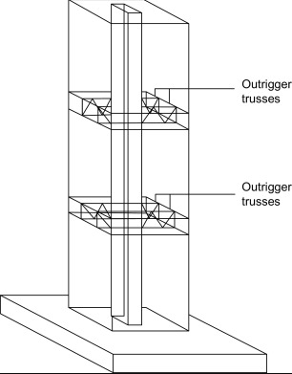
Core and Outrigger System

Slide 22
Shear Wall System
Description: Reinforced concrete or masonry walls are distributed throughout the building to resist lateral forces such as wind or earthquakes.
Function: The walls transfer lateral forces to the foundation, while the floor system distributes vertical loads.
Applications: Common in buildings requiring high lateral stiffness, especially in seismic-prone areas.
Advantages: Very effective for resisting lateral loads.
Disadvantages: Can limit flexibility of interior layouts; may require large, thick walls in lower levels.

Slide 23
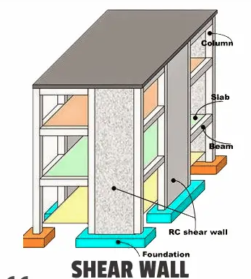

Slide 24
Braced Frame System
A system using diagonal braces (either in X or V patterns) to resist lateral loads.
Function: The braces act like trusses, transferring lateral loads to the foundation.
Applications: Common in steel-frame buildings where lateral load resistance is needed.
Advantages: Provides a lightweight and effective solution for lateral stability.
Disadvantages: Can obstruct interior floor plans; may require additional structural elements to integrate with the overall design.

Slide 25
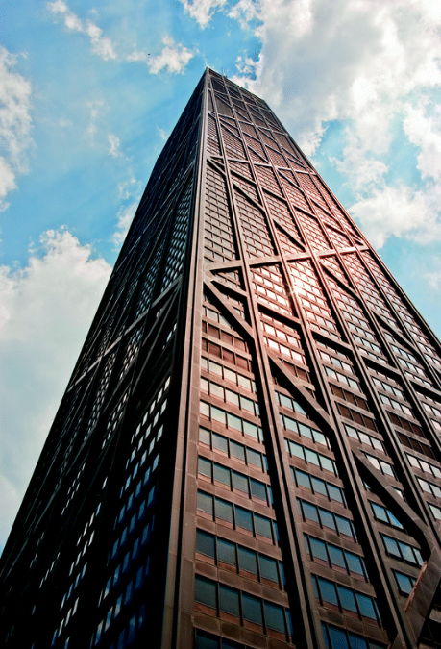
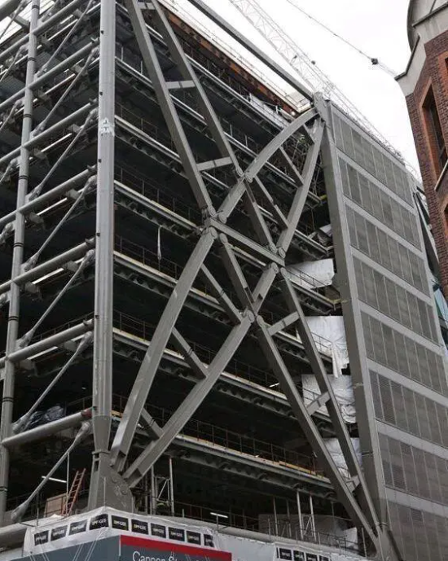
Braced Frame System

Slide 26
Tube System
Framed Tube System: A tube-like framework where the exterior columns form a "tube" to resist lateral forces. Example: John Hancock Center.
Bundled Tube System: Multiple tube-like structures bundled together, as in the Willis Tower (formerly Sears Tower), to create a rigid framework for very tall buildings.
Tube in Tube System: An outer tube that resists lateral forces, combined with a central core that supports vertical loads.

Slide 27
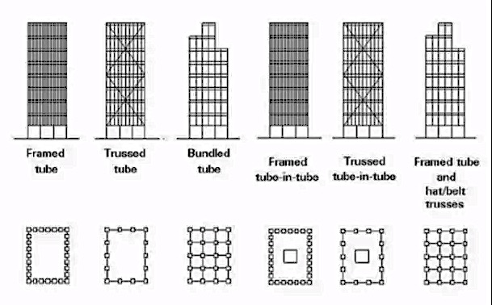
Tube Systems

Slide 28
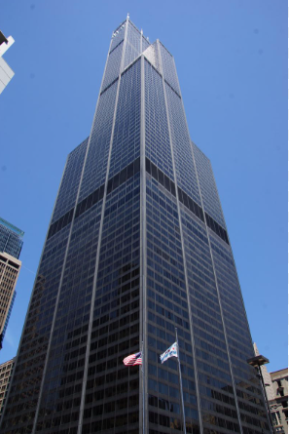
Bundled Tube System:

Slide 29
Hybrid System
Dual Systems: A combination of moment-resisting frames and shear walls or braced frames to provide enhanced resistance to both vertical and lateral forces.
Combination of Core and Braced Frames: A hybrid of core systems and external braced frames for added stability and flexibility in tall buildings.

Slide 30
Environmental Impact of Materials
The production, use, and disposal of building materials can significantly impact the environment. These impacts occur throughout the material lifecycle—extraction, manufacturing, transportation, construction, operation, and disposal.
Resource Depletion
Impact: Extraction of raw materials (e.g., sand, timber, minerals) leads to depletion of natural resources.
Example: Over-mining for cement or aggregates damages ecosystems.

Slide 31
Energy Consumption
Impact: Manufacturing materials like steel, cement, and bricks is energy-intensive and relies heavily on fossil fuels, contributing to greenhouse gas emissions.
Example: Cement production accounts for ~8% of global CO₂ emissions.
Carbon Emissions
Impact: Materials like concrete, steel, and aluminum have high carbon footprints due to energy use during production and transportation.
Example: High emissions during the manufacture of Portland cement.

Slide 32
Pollution
Air Pollution: Dust and emissions from material production, e.g., brick kilns and cement plants.
Water Pollution: Runoff from quarries and factories contaminates water sources.
Soil Pollution: Waste from construction sites degrades soil quality.
Waste Generation
Impact: Construction and demolition generate significant waste, much of which is not recycled and ends up in landfills.
Example: Non-recyclable materials like plasterboards contribute to landfill burden.

Slide 33
Habitat Destruction
Impact: Quarrying and deforestation for material production destroy habitats and biodiversity.
Example: Clearing forests for timber or mining impacts ecosystems.
Health Hazards
Impact: Toxic chemicals and particulates released during production or use (e.g., VOCs, asbestos) can harm human health.
Example: Asbestos causes respiratory diseases and cancers.

Slide 34
Water Usage
Impact: Excessive water consumption for material production strains local water resources.
Example: Concrete and brick manufacturing consume large quantities of water.
Urban Heat Island Effect
Impact: Use of materials like asphalt and concrete increases heat absorption in urban areas.
Example: Cities with extensive concrete surfaces experience higher temperatures.

Slide 35
Responsible Sourcing of Materials
Responsible sourcing in the context of building materials refers to selecting and obtaining materials in a way that minimizes environmental and social harm throughout their lifecycle, from extraction to end-of-life disposal. It emphasizes ethical, sustainable, and efficient practices that reduce the negative environmental impacts of construction activities.

Slide 36
Key Aspects of Responsible Sourcing
Sustainable Material Selection
Prioritize materials that are renewable, recyclable, or have a lower environmental footprint.
Examples: Bamboo (rapidly renewable), recycled steel, fly ash in concrete.
Local Sourcing
Use locally available materials to reduce transportation emissions and costs.
Minimizes the carbon footprint associated with long-distance material transport.

Slide 37
Recycled and Reclaimed Materials
Utilize materials salvaged from demolition or industrial by-products.
Examples: Reclaimed wood, recycled aggregates, or industrial slag in construction.
Ethical Sourcing
Ensure that raw materials are extracted and processed under fair labor conditions, avoiding exploitation and conflict resources.

Slide 38
Certified Materials
Use materials certified by recognized environmental standards like FSC (Forest Stewardship Council) for timber or Cradle to Cradle (C2C) certifications for other materials.
Ensures materials are sourced sustainably and ethically.

Slide 39
Benefits of Responsible Sourcing
Environmental Protection
Reduces deforestation, habitat destruction, and pollution.
Encourages the use of renewable and low-impact materials.
Lower Carbon Footprint
Minimizes greenhouse gas emissions by reducing energy use during material production and transportation.

Slide 40
Challenges in Responsible Sourcing
Availability: Sustainable materials may not always be accessible in certain regions.
Cost: Certified and eco-friendly materials can be more expensive initially.
Awareness: Limited knowledge about sustainable options among builders and developers.
Verification: Ensuring materials genuinely meet sustainability certifications.

Slide 41
Enhanced Resource Efficiency
Promotes recycling, reuse, and innovative design to use fewer resources.
Improved Social Responsibility
Ensures fair labor practices and ethical supply chains.
Economic Savings
Reduces costs associated with material transportation, waste management, and long-term maintenance.

Slide 42
Responsible Sourcing Certifications
a. Indian Green Building Council (IGBC) Certification
Overview: The IGBC certifies green buildings in India based on sustainable materials, energy efficiency, and environmental impact.
Key Features:
Encourages the use of locally sourced and recycled materials.
Promotes renewable energy and water-efficient systems.
Common Materials: Fly ash bricks, bamboo, and recycled aggregates.

Slide 43
b. GRIHA (Green Rating for Integrated Habitat Assessment)
Overview: India's national rating system evaluates buildings for sustainability in design and material use.
Key Features:
Focuses on low-impact building materials and waste management.
Encourages the use of natural and local resources.
Common Materials: Rammed earth, clay tiles, and recycled steel.

Slide 44
c. Bureau of Indian Standards (BIS)
Overview: BIS provides certifications for eco-friendly building materials and quality standards in India.
Key Features:
Certifies materials for durability and minimal environmental impact.
Ensures compliance with sustainable construction codes.
Common Materials: Pozzolana cement, energy-efficient windows, and eco-bricks.

Slide 45
d. Forest Stewardship Council (FSC) India
Overview: Certifies responsibly sourced timber and wood products in India.
Key Features:
Promotes sustainable forestry and reduced deforestation.
Ensures ethical practices in timber sourcing.
Common Materials: FSC-certified wood and bamboo.

Slide 46
e. EcoMark
Overview: An Indian government certification for environmentally friendly products, including building materials.
Key Features:
Covers materials with low environmental impact, such as low-VOC paints and sustainable timber.
Common Materials: Recycled glass, bio-based plastics, and eco-paints.

Slide 47
Sustainable Materials
a. Fly Ash Bricks
Source: Industrial by product from coal power plants.
Advantages:
Utilizes waste material, reducing landfill impact.
Stronger and more durable than traditional clay bricks.
Applications: Walls, foundations, and paving.

Slide 48
b. Bamboo
Source: Grows abundantly in India and is rapidly renewable.
Advantages:
Lightweight, flexible, and strong.
High tensile strength, suitable for structural applications.
Applications: Flooring, scaffolding, wall panels, and furniture.
c. Recycled Aggregates Source: Demolition waste and industrial by products.
Advantages:
Reduces demand for virgin aggregates.
Cost-effective and environmentally friendly.
Applications: Road construction, foundations, and concrete.

Slide 49
d. Rammed Earth
Source: Locally available soil compacted in layers.
Advantages:
Reduces the need for cement and bricks.
Provides natural insulation and thermal mass.
Applications: Walls and load-bearing structures.
e. Clay Tiles
Source: Locally sourced clay, often handmade.
Advantages:
Renewable, biodegradable, and aesthetically pleasing.
Excellent thermal insulation properties.
Applications: Roofing and flooring.

Slide 50
f. Recycled Steel
Source: Scrap metal from construction, automotive, and industrial sectors.
Advantages:
100% recyclable and reduces mining impacts.
Energy-efficient compared to producing virgin steel.
Applications: Structural components, beams, and reinforcements.

Slide 51
g. AAC (Autoclaved Aerated Concrete) Blocks
Source: Sand, cement, lime, and aluminum powder.
Advantages:
Lightweight and energy-efficient.
Provides excellent thermal insulation and soundproofing.
Applications: Walls, partitions, and infill materials.
h. Pozzolana Cement
Source: Fly ash, volcanic ash, or slag blended with Portland cement.
Advantages:
Low carbon footprint compared to traditional cement.
Improves durability and reduces heat of hydration.
Applications: Concrete and mortar.

Slide 52
i. Stone Dust and Quarry Dust
Source: By product of stone crushing operations.
Advantages:
Reduces reliance on sand, conserving river ecosystems.
Cost-effective and easily available.
Applications: Concrete production and pavement sub-layers.
j. Bio-Based Paints
Source: Plant-based oils and natural pigments.
Advantages:
Low VOC content, healthier for indoor air quality.
Renewable and biodegradable.
Applications: Wall coatings and finishes.

Slide 53
Details and Sequence of Activities in Construction Practices
The construction process involves a systematic sequence of activities designed to ensure efficiency, safety, and quality while delivering a structure as per design and specifications. Each phase involves specific tasks and coordination among multiple stakeholders.
Below is a detailed breakdown of the details and sequence of activities in a typical construction project:

Slide 54
Pre-Construction Phase
This phase includes planning, design, and preparation activities essential before starting physical construction.
a. Project Planning
Feasibility study and project budgeting.
Site selection and surveying.
Acquisition of required permissions (e.g., building permits, environmental clearance).
Scheduling and resource allocation.
b. Design Development
Preparation of architectural drawings, structural designs, and construction plans.
Approval of designs by relevant authorities.
Preparation of detailed estimates and bills of quantities (BOQs).

Slide 55
c. Site Preparation
Site clearance: Removing vegetation, debris, and obstructions.
Soil investigation and geotechnical studies.
Demarcation of the project site using survey equipment.
d. Procurement
Selection of contractors and subcontractors.
Procurement of materials and equipment.
Setting up site offices, storage areas, and utilities (electricity, water).

Slide 56
Construction Phase
a. Earthworks
Excavation: Digging for foundations, trenches, or basements as per drawings.
Soil Stabilization: Compacting soil and adding stabilization layers if needed.
b. Foundation Construction
Laying of footing reinforcements.
Pouring concrete for footings and columns.
Ensuring curing and testing of concrete strength.

Slide 57
c. Substructure
Construction of basement walls or retaining walls (if applicable).
Waterproofing the foundation to prevent seepage.
d. Superstructure Construction
Framing:
Erection of load-bearing walls, columns, and beams.
Reinforcement for slabs and casting concrete floors.
Brickwork or Blockwork:
Building external and internal walls using bricks, blocks, or panels.
Incorporating lintels and arches as per design.

Slide 58
Formwork and Scaffolding:
Erecting temporary structures for casting concrete.
Scaffolding to facilitate work at heights.
e. Roofing
Laying of roof trusses, slabs, or sheets.
Waterproofing and thermal insulation.

Slide 59
Utility Installation
This phase includes integrating services into the building for functionality.
a. Plumbing
Installation of pipelines for water supply and drainage.
Testing of pipe joints for leakages.
b. Electrical Work
Laying of conduits for wiring.
Fixing electrical outlets, switches, and fixtures.

Slide 60
c. HVAC (Heating, Ventilation, and Air Conditioning)
Installing ducts, vents, and units for air conditioning and ventilation systems.
d. Fire Safety and Security
Installing fire alarms, sprinklers, and extinguishers.
Setting up CCTV and security systems.

Slide 61
Finishing Phase
This phase ensures the building achieves its desired appearance and functionality.
a. Plastering and Flooring
Internal and external plastering.
Application of flooring materials like tiles, marble, or vinyl.
b. Painting and Coating
Applying primer, putty, and final paint coats.
Using weatherproof paints for exteriors.

Slide 62
c. Doors and Windows
Fixing frames and panels for doors and windows.
Installing glass panes and hardware.
d. Carpentry and Joinery
Installation of cabinets, shelves, and furniture as per design.
e. Fixtures and Fittings
Fixing bathroom fixtures like sinks, showers, and taps.
Installing kitchen counters, sinks, and other fixtures.

Slide 63
Post-Construction Phase
This phase involves final inspections, testing, and project handover.
a. Testing and Commissioning
Testing of all utilities: electrical systems, plumbing, HVAC, etc.
Checking for structural safety and stability.
b. Cleaning and Landscaping
Removal of debris and cleaning the site.
Landscaping the surrounding area as per the project plan.

Slide 64
c. Handover
Preparing and submitting final project reports.
Handing over the building to the client.
Conducting training for maintenance, if necessary.

Slide 65
Maintenance Phase
Periodic maintenance to ensure durability and functionality.
Addressing wear and tear through routine inspections.

Slide 66
Sequence of Activities in a Construction Project
The sequence typically follows these steps:
Planning and Design
Site Preparation
Excavation and Foundation
Superstructure Construction
Roofing and Utility Installation
Finishing
Inspection and Handover

Slide 67
Construction Coordination
Construction coordination refers to the organized planning, communication, and execution of various activities, resources, and stakeholders involved in a construction project. The goal is to ensure smooth workflow, prevent conflicts, and complete the project efficiently, on time, and within budget. Effective coordination is critical in complex projects involving multiple teams, contractors, and overlapping activities.

Slide 68
Key Aspects of Construction Coordination
Stakeholder Management
Identifying all key stakeholders, including project owners, contractors, architects, engineers, suppliers, and regulatory authorities.
Ensuring clear communication of goals, roles, and responsibilities.
Addressing concerns or conflicts in a timely manner.

Slide 69
Scheduling
Preparing a detailed project schedule using tools like Gantt charts or Critical Path Method (CPM).
Breaking down the project into tasks, subtasks, and milestones.
Allocating sufficient time for procurement, approvals, and unexpected delays.
Resource Management
Ensuring availability of materials, equipment, and labor when needed.
Preventing resource shortages or excess inventory.
Tracking utilization to minimize wastage and cost overruns.

Slide 70
Workflow Sequencing
Planning the sequence of construction activities (e.g., excavation before foundation, plumbing before finishing).
Avoiding overlapping or conflicting tasks to ensure smooth progress.
Considering interdependencies between activities.
Quality Control
Coordinating quality checks at various stages of construction.
Implementing standards and specifications as outlined in the project plan.
Addressing quality issues promptly to avoid rework.

Slide 71
Safety Coordination
Enforcing safety protocols and procedures.
Conducting regular safety briefings and audits.
Ensuring compliance with local safety regulations.

Slide 72
Key Activities in Construction Coordination
Pre-Construction Coordination
Finalizing project plans, blueprints, and permits.
Setting up communication channels and protocols.
Conducting pre-construction meetings with all stakeholders.
Establishing a project management team.

Slide 73
On-Site Coordination
Monitoring daily construction activities.
Addressing site-specific challenges, such as weather conditions or access issues.
Coordinating deliveries of materials and movement of equipment.
Managing subcontractors and ensuring adherence to timelines.

Slide 74
Technical Coordination
Integrating architectural, structural, and MEP (Mechanical, Electrical, Plumbing) designs.
Resolving discrepancies or conflicts between design drawings and on-site conditions.
Collaborating with engineers and consultants to make technical decisions.
Documentation Coordination
Maintaining accurate records of contracts, permits, invoices, and inspection reports.
Documenting changes in design, schedule, or scope.
Ensuring all stakeholders have access to updated plans and documents.

Slide 75
Coordination with Authorities
Liaising with local authorities for compliance with building codes and regulations.
Obtaining necessary approvals for inspections, environmental clearances, or utility connections.
Risk Management
Identifying potential risks (e.g., delays, cost overruns, or accidents).
Preparing contingency plans for unforeseen events.
Mitigating risks through proactive communication and planning.

Slide 76
Coordination Tools and Techniques
Project Management Software
Tools like Microsoft Project, Primavera, or Procore for scheduling, tracking, and reporting.
Building Information Modeling (BIM)
3D modeling to integrate design and construction workflows.
Identifies conflicts (e.g., clashes in MEP systems) before execution.

Slide 77
Communication Platforms
Tools like Slack, Zoom, or email for real-time communication.
Centralized repositories for sharing documents and updates.
Coordination Meetings
Regular progress meetings to review status, discuss challenges, and plan next steps.
Pre-task briefings for daily activities.

Slide 78
Challenges in Construction Coordination
Communication Gaps: Miscommunication between stakeholders can lead to errors and delays.
Resource Constraints: Shortages of materials, labor, or equipment can disrupt schedules.
Design Changes: Modifications in design during execution require re-coordination.
Unforeseen Events: Weather conditions, labor strikes, or supply chain issues can impact progress.

Slide 79
Benefits of Effective Construction Coordination
Timely Completion:
Reduces delays and keeps the project on track.
Cost Control:
Prevents budget overruns by efficient resource allocation.
Improved Quality:
Ensures adherence to specifications and standards.
Enhanced Safety:
Reduces accidents by enforcing safety protocols.
Stakeholder Satisfaction:
Maintains transparency and trust among all parties.

Slide 80
Masonry
Masonry is a construction technique that involves assembling individual units, such as bricks, stones, concrete blocks, or other materials, using mortar as a binding agent. It is one of the oldest and most reliable construction methods, widely used for walls, buildings, and other structures due to its strength, durability, and aesthetic appeal.

Slide 81
Types of Masonry Construction
Brick Masonry
Uses bricks as the primary construction material.
Commonly used in walls, partitions, and facades.
Types of Bricks:
Burnt Clay Bricks
Fly Ash Bricks
Concrete Bricks
Engineering Bricks
Advantages:
High compressive strength
Fire resistance
Uniform shape and size
Disadvantages:
Requires skilled labor
Brittle in tension

Slide 82
Stone Masonry
Uses natural stones like granite, limestone, or sandstone.
Suitable for heavy-load structures, foundations, and monuments.
Types of Stone Masonry:
Rubble Masonry – Uses irregularly shaped stones.
Random Rubble Masonry: No uniform pattern.
Coursed Rubble Masonry: Laid in horizontal courses.
Ashlar Masonry – Uses precisely cut and dressed stones.
Ashlar Fine Masonry: Stones are finely finished.
Ashlar Rough Masonry: Rough but uniform-sized stones.
Advantages:
High durability and weather resistance.
Aesthetic appeal.
Disadvantages:
Expensive and labor-intensive.
Heavyweight increases foundation costs.

Slide 83
Concrete Block Masonry
Uses concrete blocks instead of bricks or stones.
Used in modern construction for its strength and ease of installation.
Types of Concrete Blocks:
Solid Concrete Blocks
Hollow Concrete Blocks
Aerated Autoclaved Concrete (AAC) Blocks
Advantages:
Lightweight and strong.
Good insulation properties.
Faster construction than brick or stone masonry.
Disadvantages:
Requires special mortar.
Aesthetic appeal is lower than bricks or stones.

Slide 84
Composite Masonry
Combination of two different materials, such as bricks and stones, for enhanced strength and cost efficiency.
Used in multi-story buildings and decorative walls.

Slide 85
Reinforced Masonry
Reinforces traditional masonry with steel bars to improve tensile strength.
Used in earthquake-resistant structures and high-rise buildings.

Slide 86
Types of Masonry Bonds
1. Brick Bonds
Stretcher Bond – Bricks laid lengthwise in all rows.
Header Bond – Bricks laid with their short side (header) facing out.
English Bond – Alternating rows of stretchers and headers.
Flemish Bond – Alternating stretchers and headers within the same row.
Rat Trap Bond – Bricks arranged to create a hollow cavity for insulation.

Slide 87
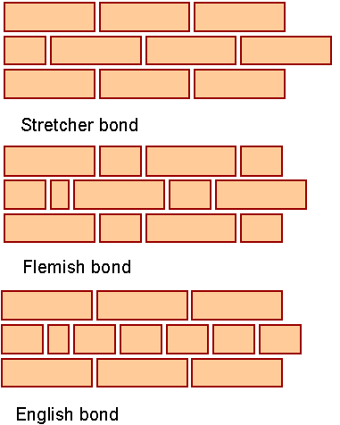
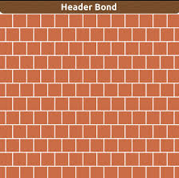
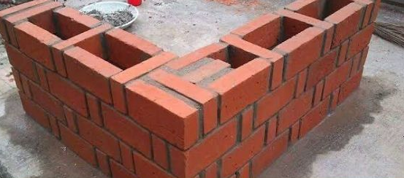
Rat Trap Bond

Slide 88
Stone Masonry
Stone masonry can be broadly classified into two main types: Rubble Masonry and Ashlar Masonry. Each has further subtypes based on construction techniques and stone arrangement.

Slide 89
Rubble Masonry
Rubble masonry consists of irregularly shaped stones with rough surfaces, usually bound together with mortar. It is less expensive and more commonly used for walls and foundations.

Slide 90
Types of Rubble Masonry
Random Rubble Masonry – Stones are laid without a uniform pattern.
Uncoursed Random Rubble: Stones are arranged randomly with no horizontal layers.
Coursed Random Rubble: Stones are arranged in roughly horizontal layers.

Slide 91
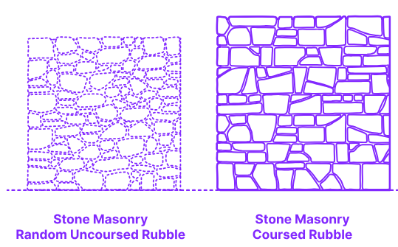

Slide 92
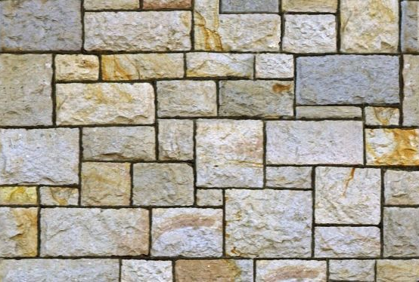
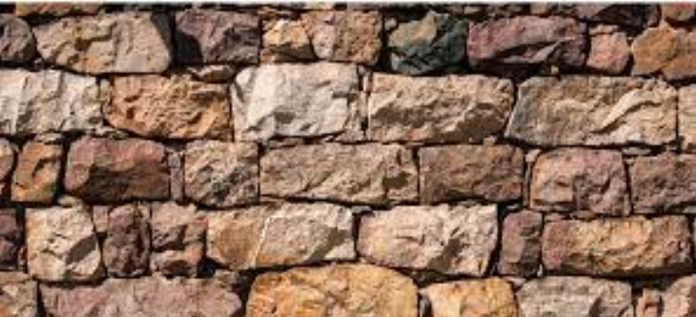
Squared Rubble Masonry – Stones are roughly squared before laying.
Uncoursed Squared Rubble: Squared stones are placed without horizontal alignment.
Coursed Squared Rubble: Squared stones are laid in horizontal courses.

Slide 93
Dry Rubble Masonry
Dry Rubble Masonry- Stones are stacked without mortar (used in dry stone walls).
Polygonal Rubble Masonry – Stones are shaped into polygons for a tight fit.
Flint Rubble Masonry – Small flint stones used with mortar for strength.

Slide 94
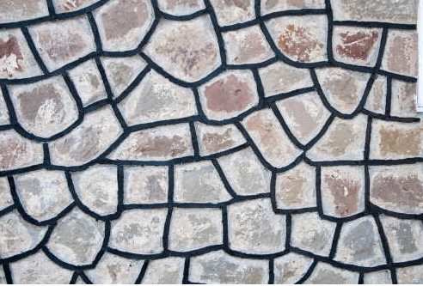
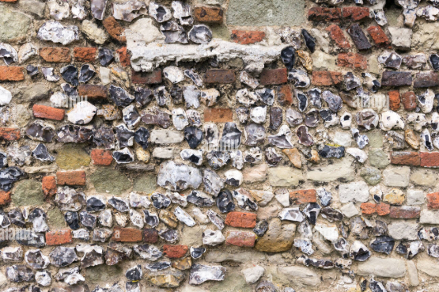
Polygon Rubble Masonry
Flint Rubble Masonry

Slide 95
Ashlar Masonry
Ashlar masonry consists of precisely cut stones laid in regular courses with thin mortar joints. It is more expensive and used in decorative or high-quality structures.
Types of Ashlar Masonry
Ashlar Fine Masonry – Highly finished, uniform stones with minimal mortar gaps.
Ashlar Rough Masonry – Stones are roughly finished, with slightly uneven surfaces.

Slide 96
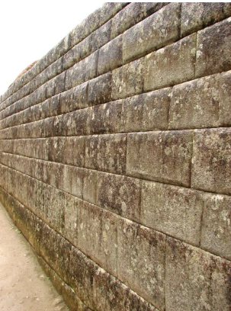
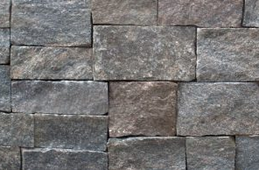
Ashlar Fine Masonry
Ashlar Rough Masonry

Slide 97
Ashlar Block in Course – Large rectangular blocks laid in horizontal layers.
Ashlar Chamfered Masonry – Edges of stones are chamfered (beveled) for a distinct look.
Ashlar Backed with Rubble – A combination of ashlar in the front and rubble at the back for economy.
Ashlar Facing – Ashlar masonry on the exterior, with a different material backing.

Slide 98
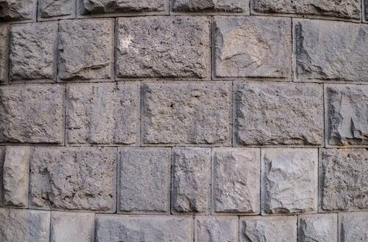
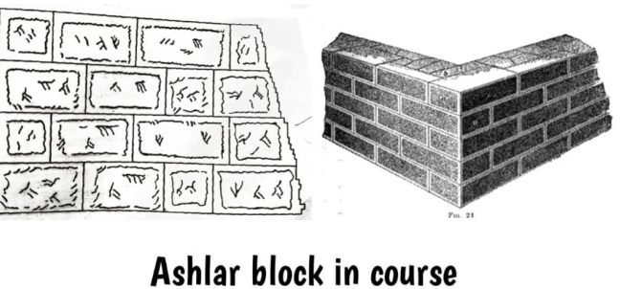
Ashlar Chamfered Masonry

Slide 99
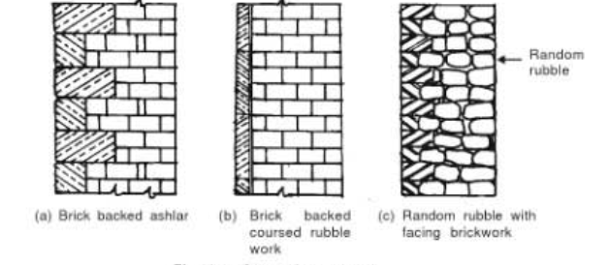

Slide 100
Flooring
Flooring is a fundamental element in building construction, serving both functional and aesthetic purposes. At its most basic, flooring is the finished surface of a building’s interior on which people walk, and it plays several critical roles:

Slide 101
Structural Support
Load Bearing
The floor must support the weight of occupants, furniture, and other loads. In structural systems, floors are designed to carry both permanent loads (the weight of the floor itself and fixed fixtures) and live loads (moving or temporary loads such as people and movable objects).
Types of Structural Floors:
Cast-in-Place Concrete Floors: Poured on site, these offer durability, fire resistance, and sound insulation.

Slide 102
Precast Concrete or Hollow-Core Slabs: Manufactured off-site and assembled on-site, providing faster installation with quality control advantages.
Timber or Steel Decking: Often used in multi-story buildings where reducing weight is important.

Slide 103
Layered Composition
Flooring systems typically consist of multiple layers, each serving a specific purpose
Subfloor/Base: This is the structural element that provides the main support. It may be a concrete slab, wooden joists with a sheathing, or another engineered platform.

Slide 104
Underlayment or Intermediate Layers: These layers may include insulation, vapor barriers, or sound-dampening materials. They serve to smooth out minor irregularities in the subfloor, control moisture, and improve thermal or acoustic performance.
Finish Floor: The topmost layer is the visible and walkable surface. It can be made of various materials such as ceramic tiles, natural stone, wood, vinyl, laminate, or carpet. The finish floor is chosen based on factors like durability, aesthetics, ease of maintenance, and suitability for the intended use of the space.

Slide 105
Aesthetic and Functional Considerations
Visual Appeal: Flooring contributes significantly to the interior design of a space. The choice of material, color, and pattern can influence the overall look and feel of a room.
Comfort and Safety: A well-designed floor not only enhances comfort but also improves safety. For example, certain floor finishes offer slip resistance, which is crucial in areas prone to moisture.
Thermal and Acoustic Performance: Some flooring systems incorporate insulation to keep spaces warm, while acoustic underlays or floating floors can reduce noise transmission between levels.

Slide 106
Installation and Maintenance
Preparation: A properly prepared subfloor is essential. This means ensuring the surface is level, clean, and free of debris. Inadequate preparation can lead to issues like cracking or uneven surfaces.
Installation Techniques: The method of installation varies with the material. For instance, tiles are typically set with adhesive and grouted, while wood floors might be nailed, glued, or floated over a subfloor.

Slide 107
Long-Term Maintenance: The durability of the floor and the ease of maintenance are key factors. Some finishes may require periodic sealing or polishing, while others, like certain resilient flooring systems, are designed for minimal upkeep.

Slide 108
Overall Impact on Building Performance
Integration with Other Building Elements: Flooring works in tandem with other systems—such as ceilings, electrical, and plumbing—to create a cohesive and functional interior environment.
Energy Efficiency: The thermal properties of a floor can contribute to a building’s energy efficiency, especially when insulation is part of the floor system.
Acoustics: Floors help control sound transmission between different spaces, which is particularly important in multi-story buildings or spaces like offices and apartments.

Slide 109
Flooring Finishes and Materials
A. Types of Floor Finishes
Ceramic and Porcelain Tiles: Popular in commercial and residential spaces for their durability and ease of cleaning. Installation requires proper setting mortars and grouting, with attention to expansion gaps.
Natural Stone: Provides a premium finish but requires careful sealing and maintenance due to potential porosity and staining.

Slide 110
Wooden Floors:
Offer warmth and aesthetic appeal. Subfloor moisture control, expansion gaps, and proper acclimatization of wood are essential to prevent warping and cracking.
Vinyl, Linoleum, and Laminate: These are versatile and often used where ease of maintenance and cost-effectiveness are key considerations.
Carpets: Provide comfort and sound insulation but require a stable, flat substrate and often a specific underlay system.

Slide 111
Wooden Floors:
Offer warmth and aesthetic appeal. Subfloor moisture control, expansion gaps, and proper acclimatization of wood are essential to prevent warping and cracking.
Vinyl, Linoleum, and Laminate: These are versatile and often used where ease of maintenance and cost-effectiveness are key considerations.
Carpets: Provide comfort and sound insulation but require a stable, flat substrate and often a specific underlay system.

Slide 112
Technical Terms in Flooring
Floor Finish: The top surface of the floor is known as wearing surface or floor finish.
Topping: The topmost layer of the floor provided over the under layer or over base course in the absence of under layer, is termed as topping.
Under Layer: The layer of material provided in between the base and floor topping.

Slide 113
Base Course: The prepared surface on which the floor topping or under layer is laid is called base, and the material used for this purpose is known as base course.
Rubble filling: The layer consists of gravel, pebbles or dry bricks having thickness varying from 50 to 100 mm is known as Rubble filling.
Bedding: A layer of mortar applied to the base or sun-floor and brought to a prescribed level is called bedding.
Screeds: The narrow strips of wood, bands of plaster or pieces of tiles, laid on the floor to act as a guides for bringing the topping to a true and even surface, are called as screeds.

Slide 114
Floor boards: The wooden boards which form the floor topping are known as floor board.
Bridging joists: The horizontal structural members, placed along shorter span immediately below the floor topping are termed as bridging joists.
Binder: The horizontal structural members placed at right angles to bridging joists to take their load and that of the floor topping are known as binders or binding joists.

Slide 115
Girders: The horizontal structural members placed to support the load of binders, bridging joists and that of the floor toppings are termed as girders.

